Slide 1
Final Project Report
Forecasting Walmart Sales Based on Ensemble Learning
Li Shengshu
Student ID: 20746064

Slide 2
Contents
Data Analysis
Analyzing sales curve of different stores by state
Analyzing sales curve of different departments by state
Analyzing sales curve of different items by department
Data Processing
Format transformation
Features enlarging
Data Cleaning
Filling and dropping missing values
Model Calculation
Random Forest
Gradient Boosting Decision Tree
Summary

Slide 3
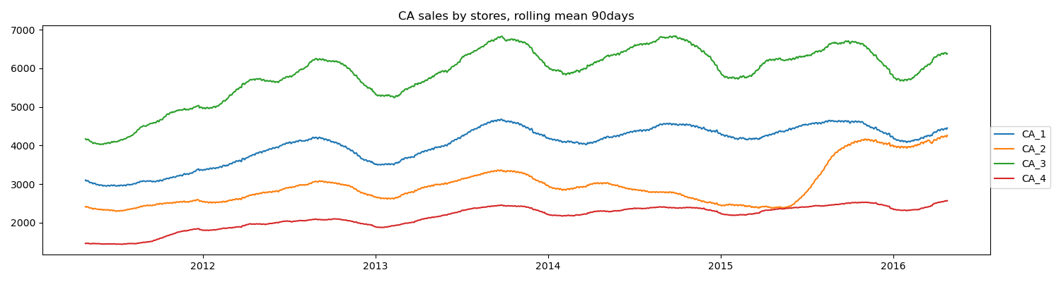
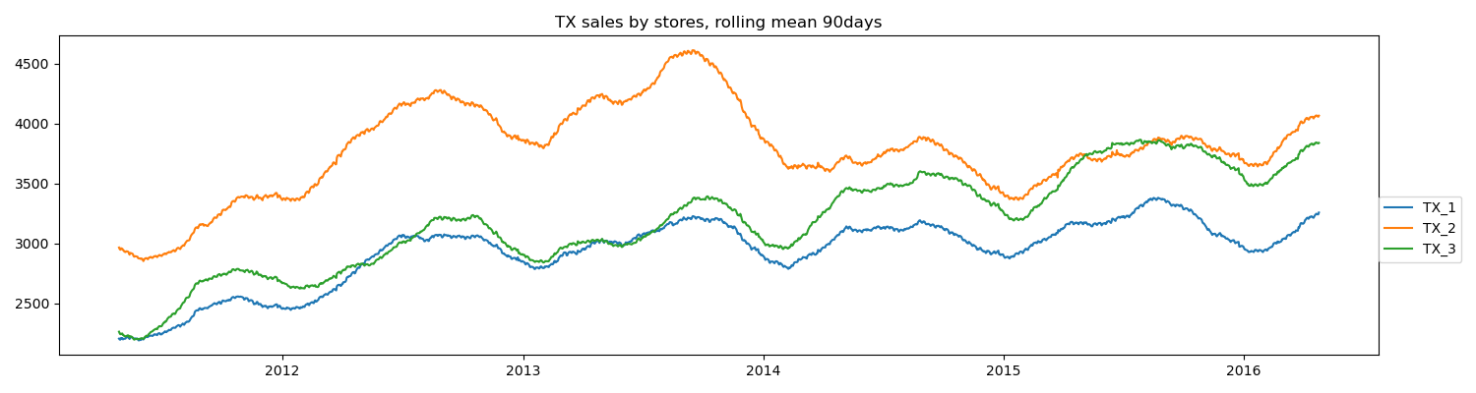
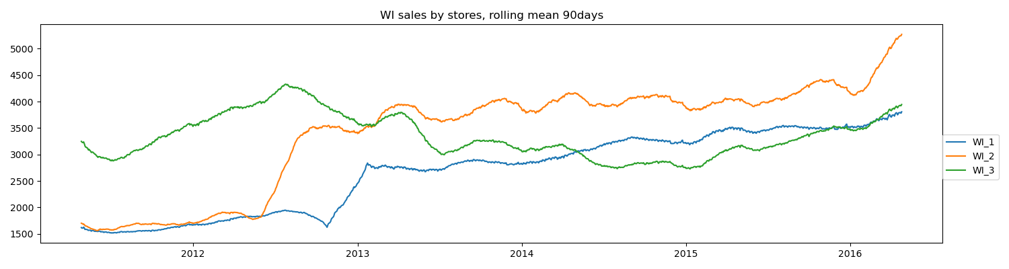
Data Analysis-1
Analyzing sales curve of different stores by state
The commodities are sold in 3 different states
California : 4 different stores
Texas: 3 different stores
Wisconsin: 3 different stores
The sales in various states are highly cyclical
Peaking at the end of the year
Bottoming at the beginning of the year
Sales in all stores is rising slowly
The sales curves of different stores by state

Slide 4
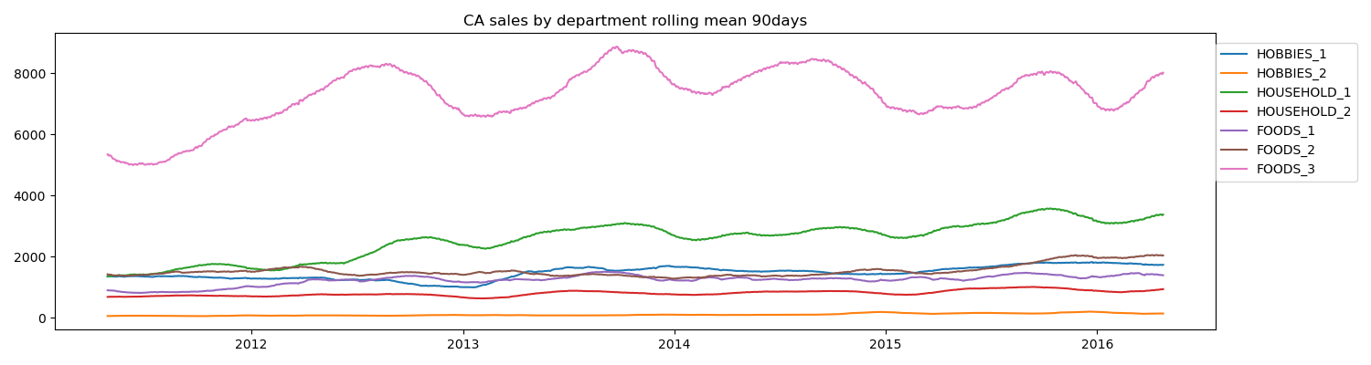
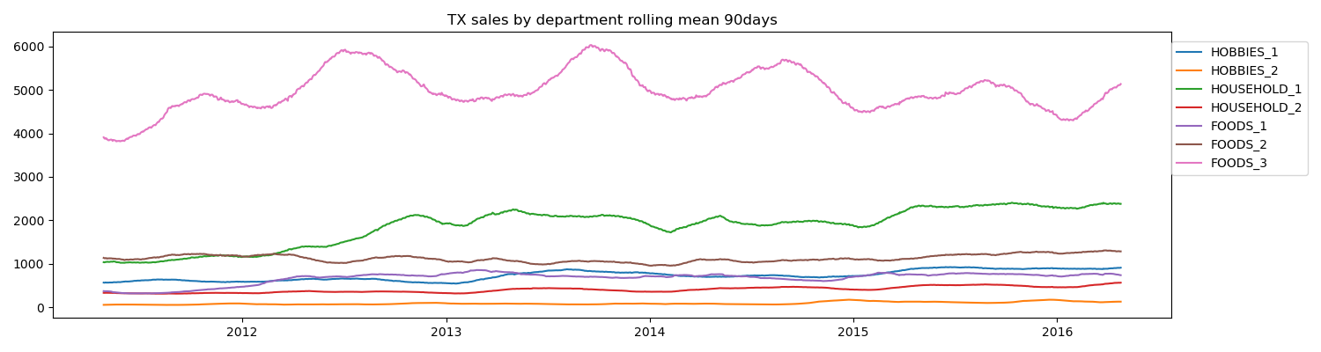
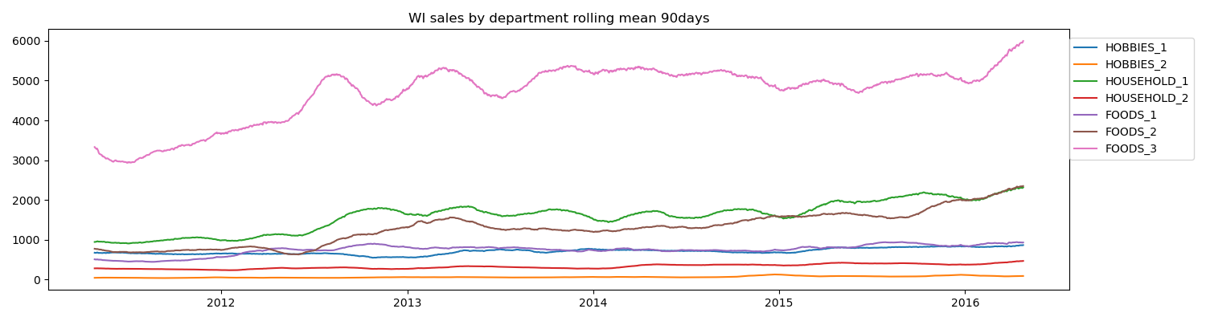
Data Analysis-2
Analyzing sales curve of different departments by state
The commodities are sold in 3 different categories
Hobby : 2 different departments
Household: 2 different departments
Food: 3 different departments
The sales in various departments are highly cyclical
Peaking at the end of the year
Bottoming at the beginning of the year
Sales of commodities in different departments are significant different
The sales curves of different departments by state

Slide 5
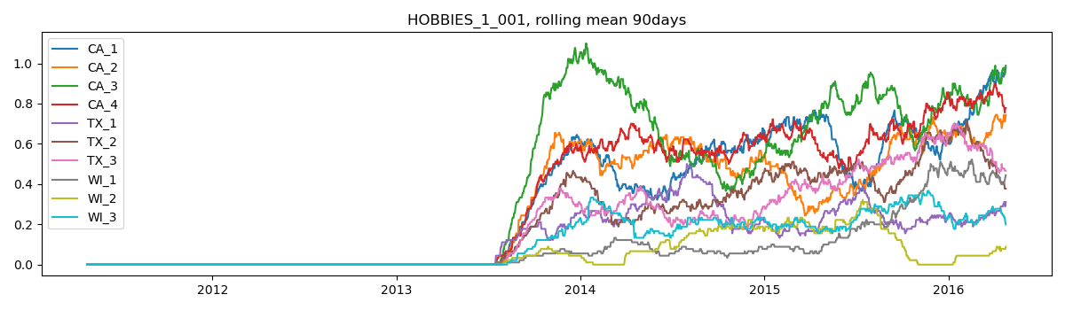
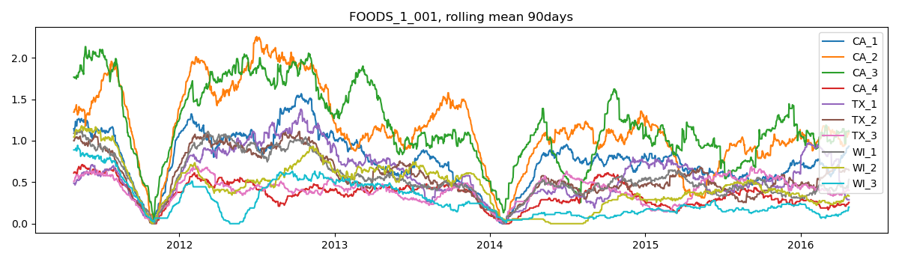
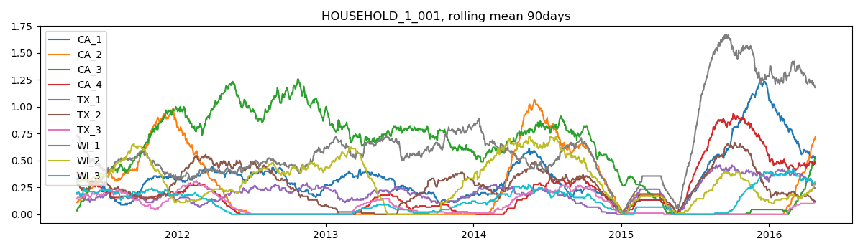
Data Analysis-3
Analyzing sales curve of different items by department
Different items in different time have different sales volumes
Some goods are on sale only after a certain time
For example: HOBBIES_1_001
Some goods are not on sale on certain time
For example: FOODS_1_001
Some goods have no obvious regularity in time
For example: HOUSEHOLD_1_001
It may be better to train the model with the data set of the recent period
The sales curves of certain items by department

Slide 6
Data Processing-1
Format transformation
The model used later cannot be used for time series analysis, so time must be analyzed as a feature
Different id parts also can be also regard as features

Slide 7
Data Processing-2
Features enlarging
Each kind of goods has 1913 days of sales data
1913 characteristics is not conducive to the training of the model
It is necessary to classify the days according to the calendar
Each day has 8 other features which can be used in model training

Slide 8
Data Cleaning-1
Interpolate the missing value
In the original data, the prices of some commodities are missing at some times
the Interpolation is an appropriate way used to calculate the value of such prices

Slide 9
Data Cleaning-2
Drop the missing value
In the previous data training, the Cartesian Product are used
Some inexistence items have be create
These elements that should not have created should be dropped

Slide 10
Model Calculation-1
Random Forest Regression
The samples and the features ought to be chosen randomly and classified by Trees.
In previous data analysis, some periodic data relationships have been found.
In chronological order, the next 28 days to be predicted will be in May and June, so the training data can be selected from these two months.
More strictly speaking, the data can be chose from the past two years for training.

Slide 11
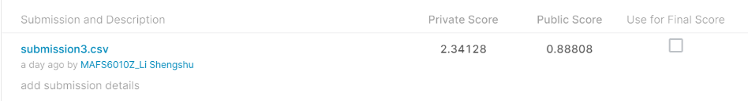
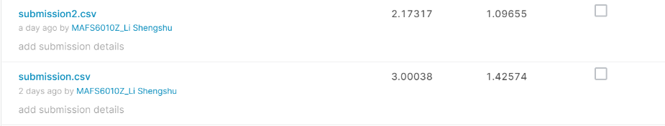
Model Calculation-2
Random Forest Regression
Brief introduction
The “submission.csv” obtained from the training data without pre-selection
The “submission2.csv” obtained from the training data with pre-selection of month
The “submission3.csv” obtained from the training data with pre-selection of month and year
The more pre-selection processed, the less the model will be affected by noise

Slide 12
Model Calculation-3
Gradient Boosting Decision Tree
The previous calculation of Random Forest Regression shows that pre-selected data is better for model training
The GBDT can directly use the pre-selected data and make a comparison with Random Forest Regression model

Slide 13
Model Calculation-4
Gradient Boosting Decision Tree
Brief introduction
The “submission3.csv” obtained from the training of Random Forest model
The “submission_gbt.csv” obtained from the training of LGBT model
The result of LGBT model is better in public score but lower in private score
Two ensemble model might be at the same level
The pre-selection of data might be much more important than model selection

Slide 14
Summary
This paper mainly uses the Ensemble Learning method to predict the sales volume of each commodity of Walmart in the next 28 days. In the whole prediction process, this paper analyzes, processes and cleans the data in order, and finally uses Random Forest and Gradient Boosting Decision Tree to predict the sales volume. The final result is satisfactory and explainable in some extent.

Slide 15
Thanks

